Slide 1
Early Repair Usage Guide
Mobile version
Home Service Network

Slide 2
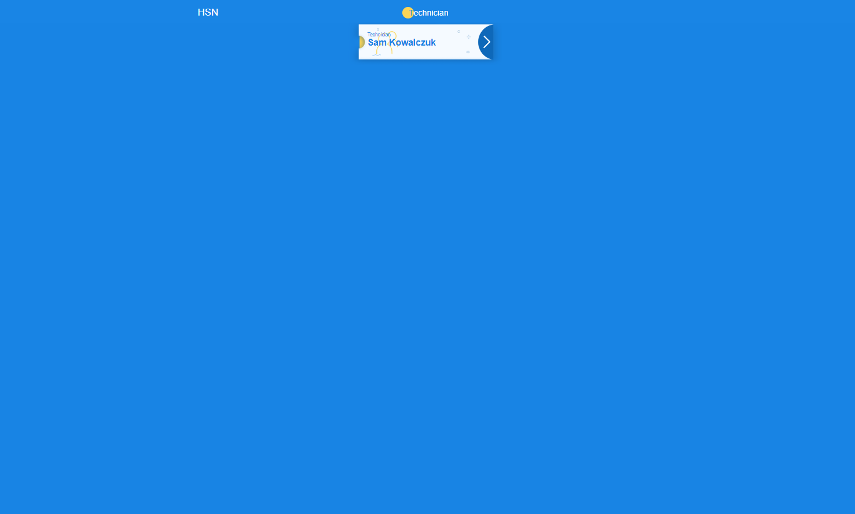
Choose your name

Slide 3
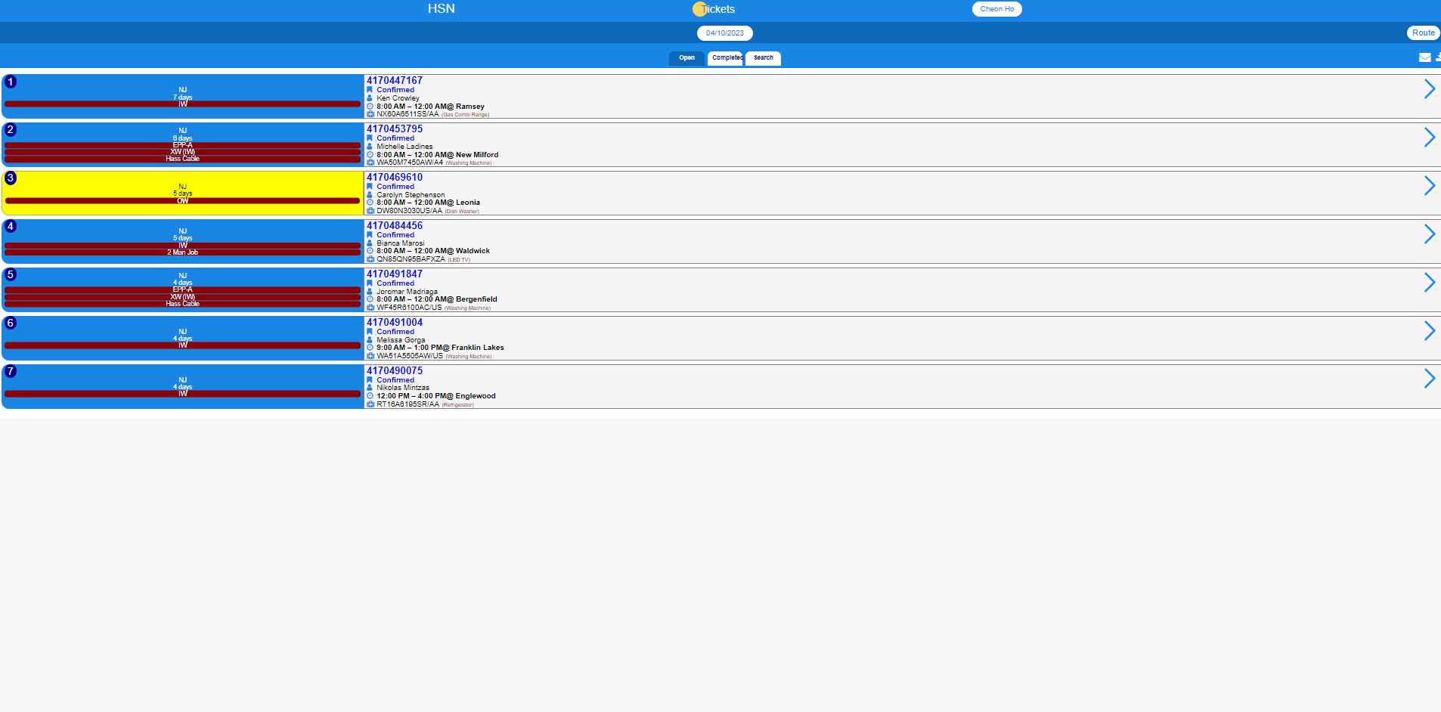
Choose
the date

Slide 4
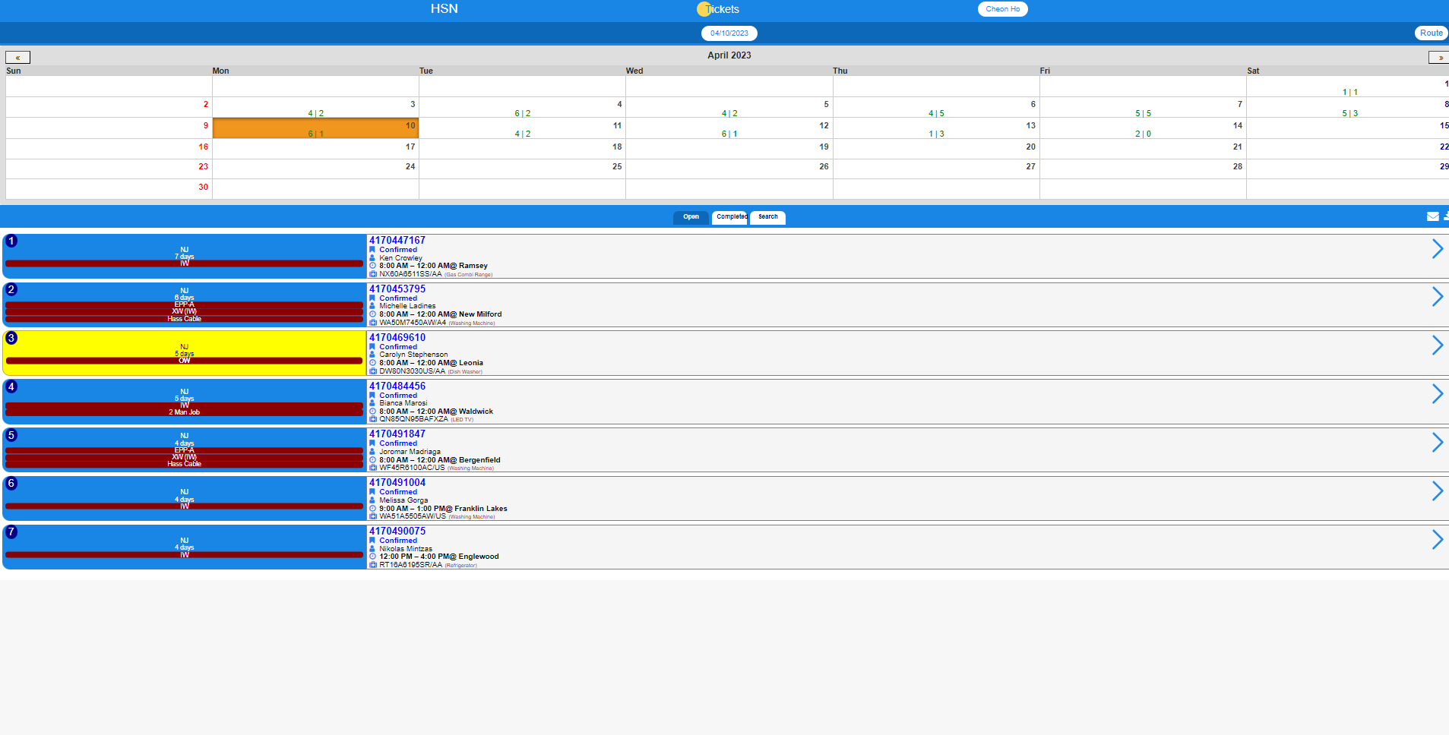
AM
PM
This indicates the number of tickets you have in AM
This indicates the number of tickets you have in PM
You can view the schedule for that date by selecting the date you want

Slide 5
Select Route

Slide 6
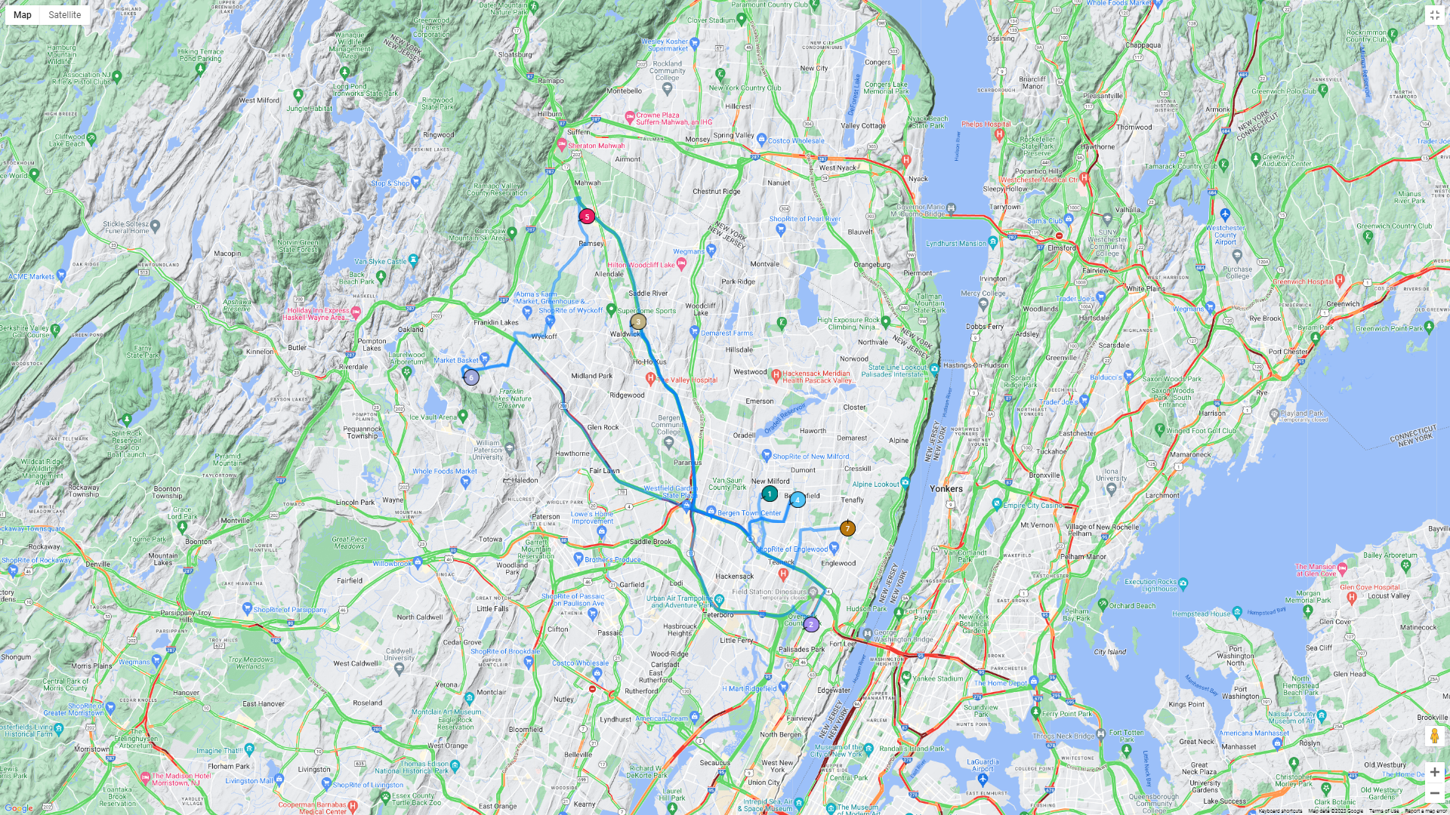
If you press the route, you can see a map of the schedule on that day

Slide 7
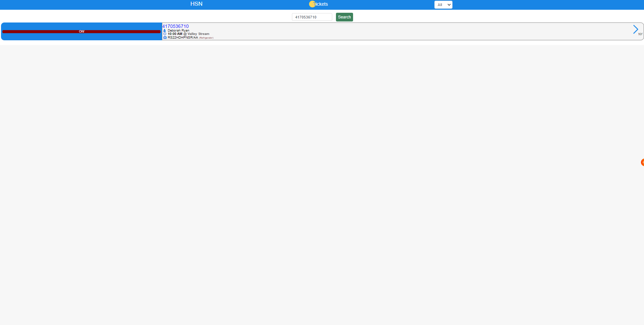
You can see the ticket.
To view ticket information, press the ticket number

Slide 8
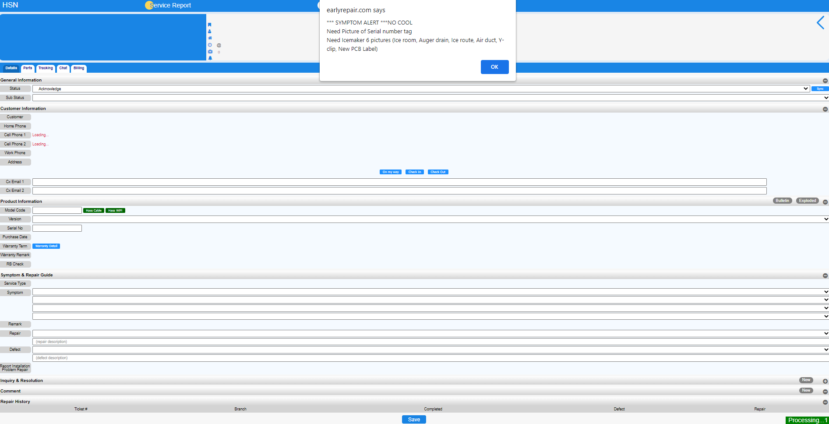
You can’t ignore the banner when it pops up !!!!!

Slide 9
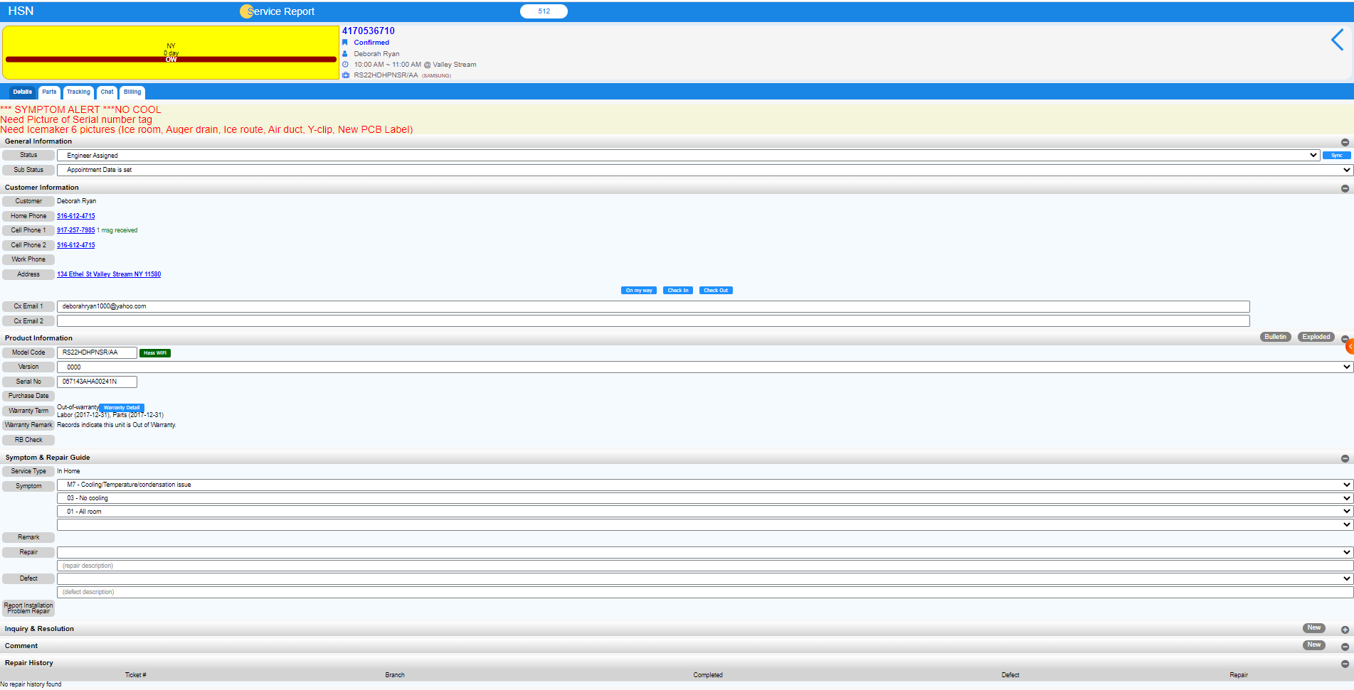
You can view cx, unit and inquiry information by clicking on the detail
Be sure to check the service type !!!
Press the plus button to view the note and press new to write the note

Slide 10
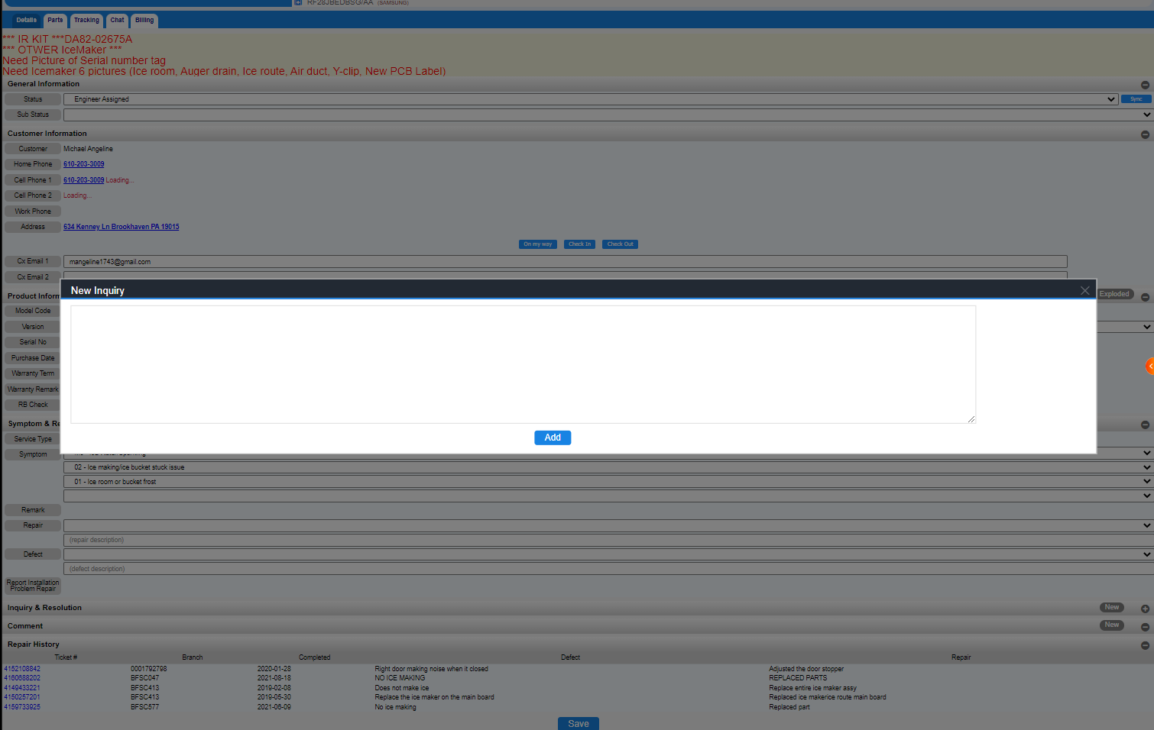
When you press the new button, the New Inquiry window appears

Slide 11
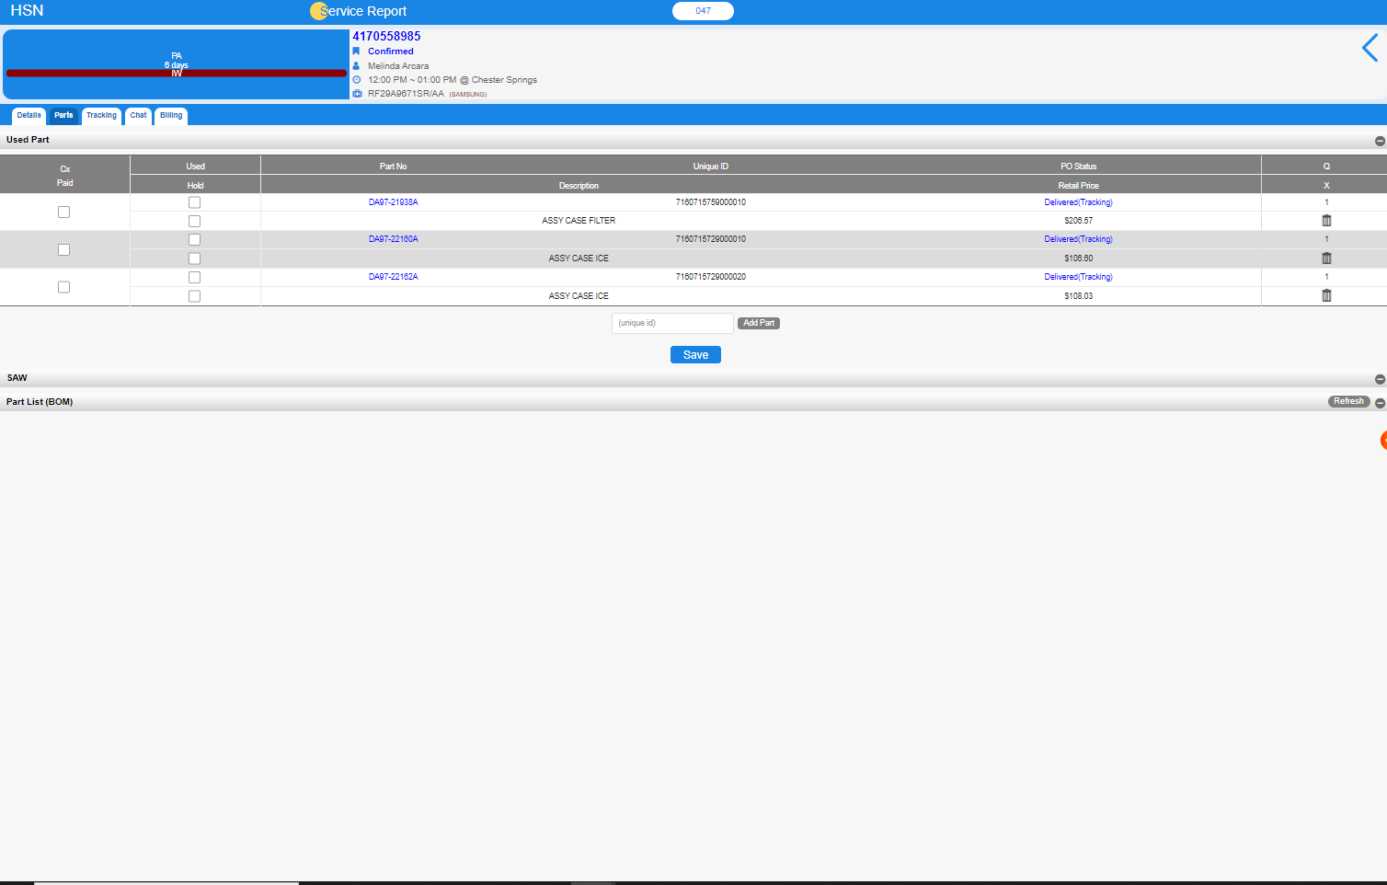
You can check the part information by pressing the part button
Unique ID = Invoice number
If there is a Unique ID, the part has arrived
Before you do the completed,
you have to erase the unused parts and leave the used parts

Slide 12
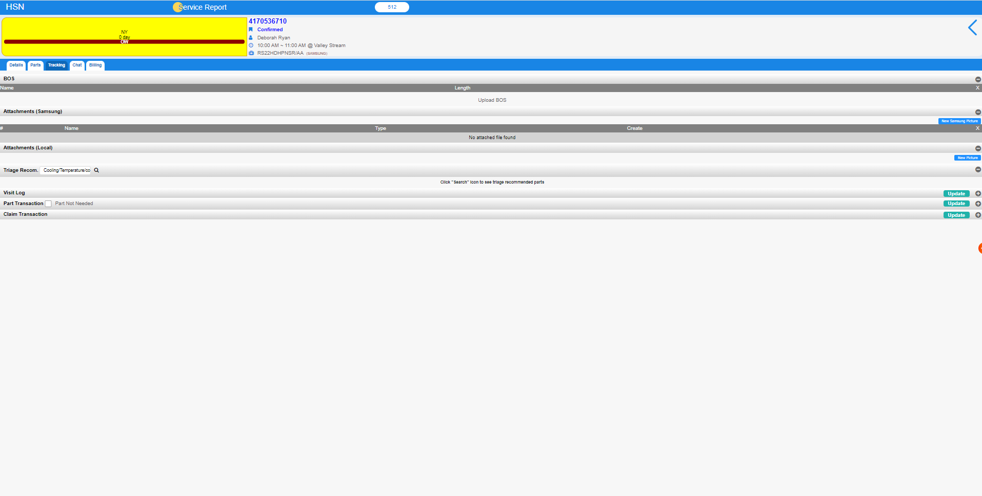
Use SS picture button for uploading picture.
Used to communicate with TS
You can see the picture by pressing the tracking button
Photos Only for HSN

Slide 13
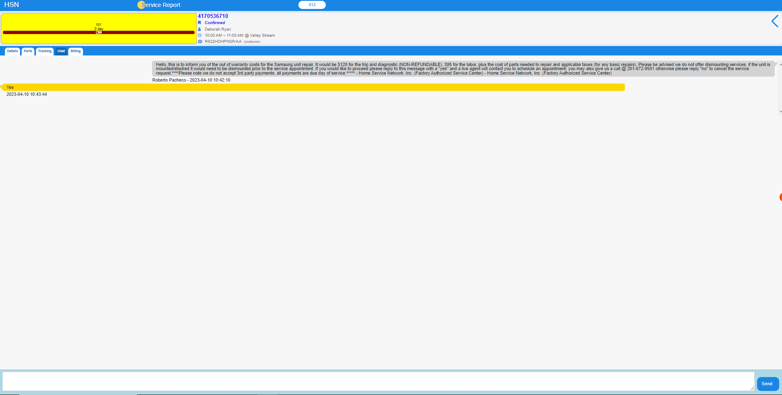
Press the chat button to view the conversation between the CX and the scheduler

Slide 14
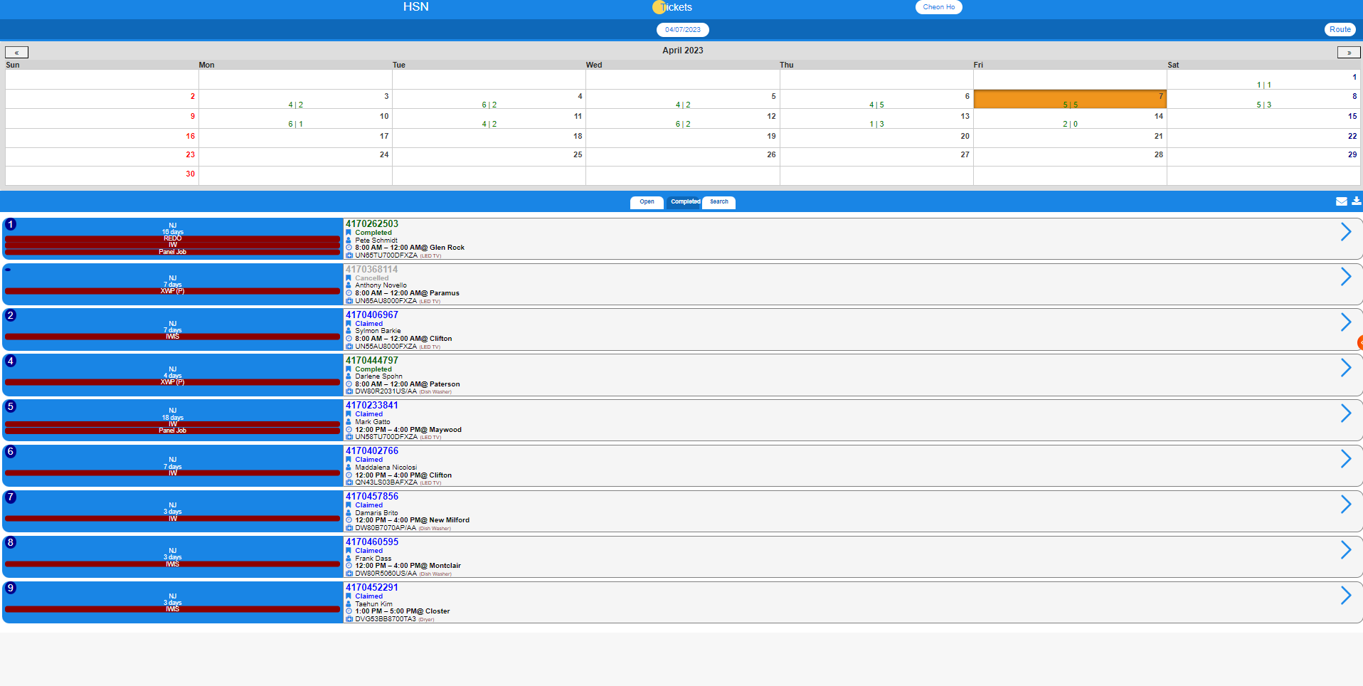
You can see the completed tickets by pressing the Completed button

Slide 15
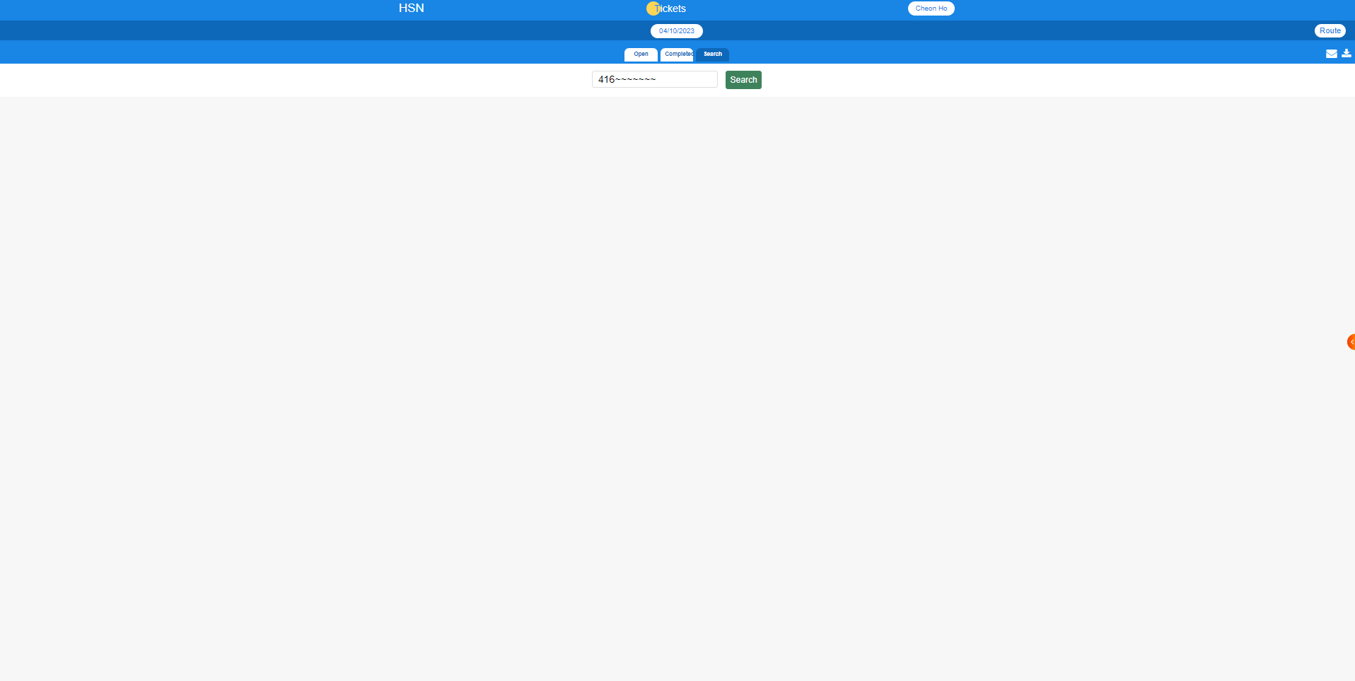
You can find the ticket you want by pressing the search button and searching for the ticket !!!!

Slide 16
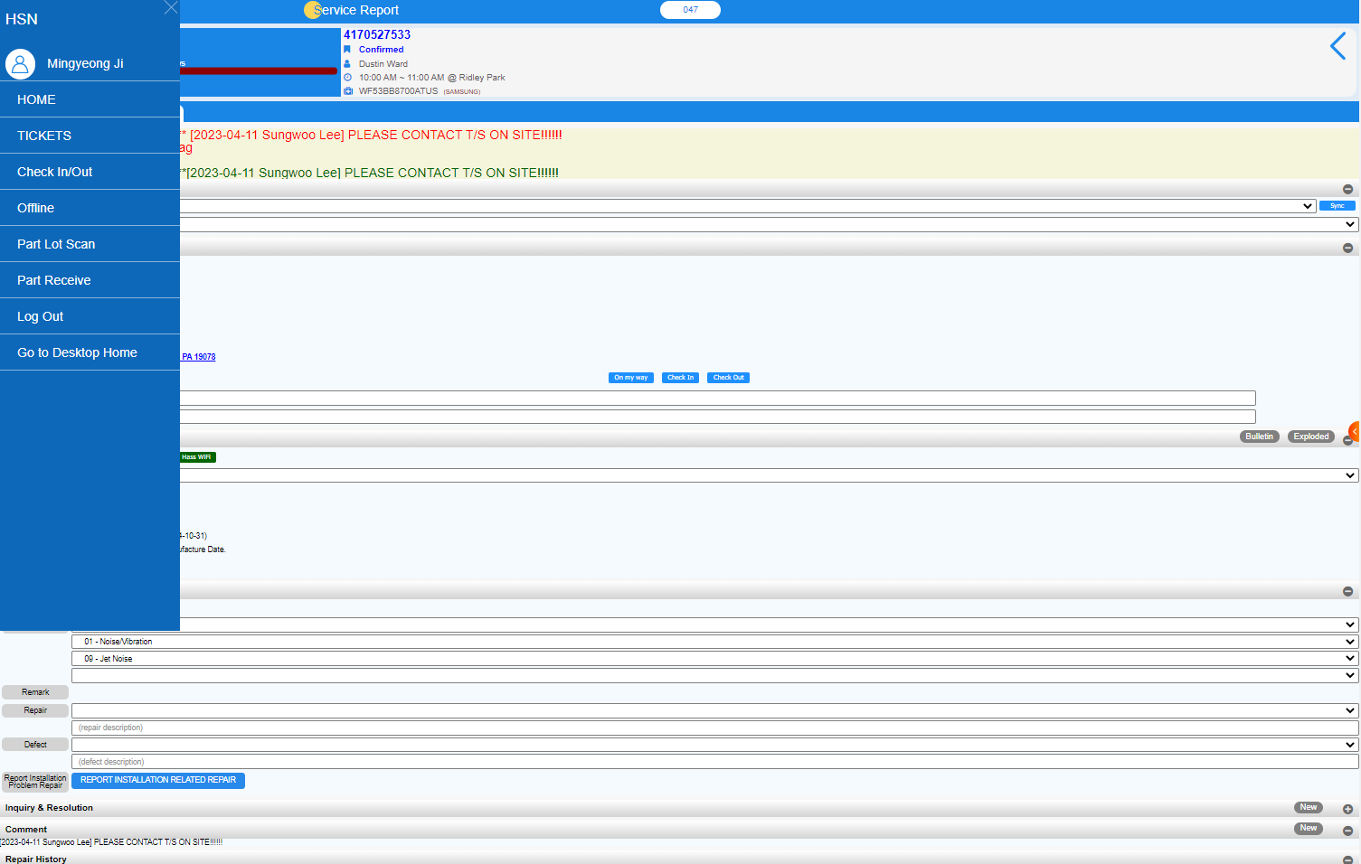
If you press go to desktop home, you can go to the desktop version

Slide 17
If you have any question,
Please do not hesitate to contact the Triage team
Home Service Network

